Slide 1



Olympics Data Analysis
Data-Driven Insights into Olympic Performance (1976 - 2008)
by Dhruv Singh
Notes:
1

Slide 2

Introduction to the Project
Data Exploration
Olympic data from 1976 to 2008.
Key Focus
Trends, top performers, athlete performance.
Analysis Areas
Medal distribution, gender participation, country trends.
Predictive Analysis
Estimate medal chances based on factors.
Notes:
2

Slide 3

Technologies & Tools
Programming
Python
Libraries
Pandas, NumPy, Matplotlib, Seaborn, Scikit-learn
Data Analysis
SQL, Excel
Machine Learning
Logistic Regression
Notes:
3

Slide 4
Dataset Overview
Data Scope
Key Columns
Olympic medal winners from 1976 to 2008.
City
Year
Sport & Discipline
Athlete Name
Country
Medal
Gender
Notes:
4

Slide 5
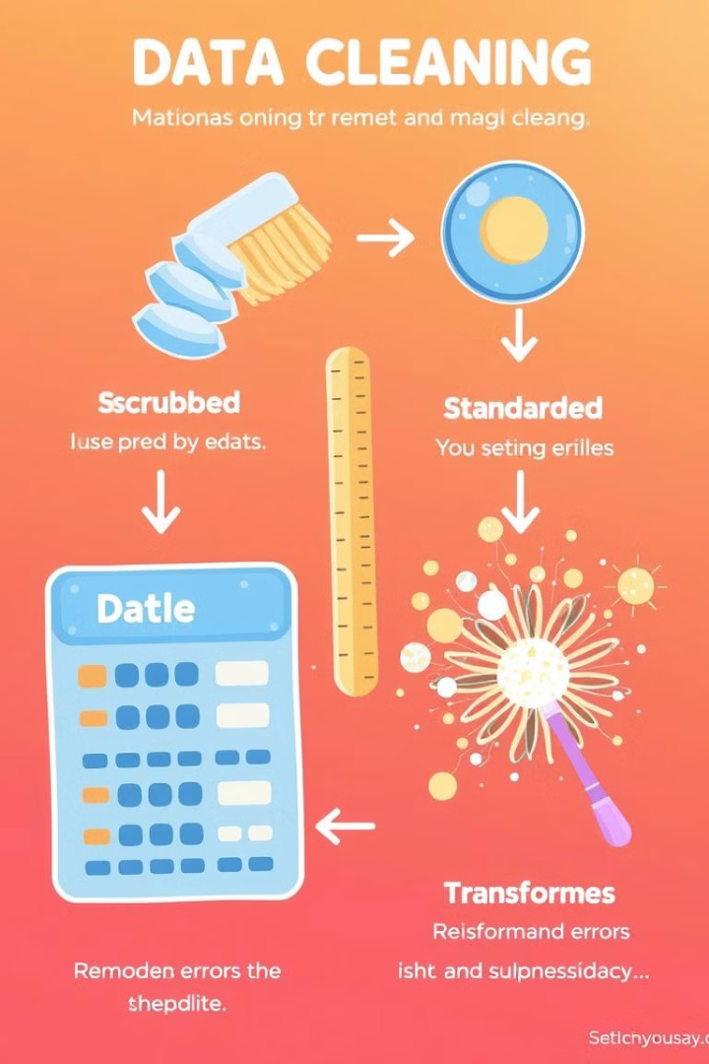
Data Cleaning & Preprocessing
Missing Values
Data Standardization
Removed null values from key columns.
Converted data types, removed duplicates, formatted names.
Feature Engineering
Added features like total medals, gender ratio, athlete performance.
Notes:
5

Slide 6
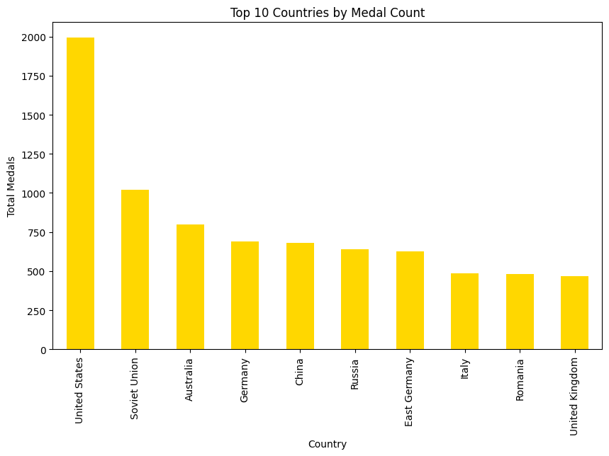
Medal Distribution by Country
Key Insights : The United States, Soviet Union, and China dominate the medal tally.
Notes:
6

Slide 7
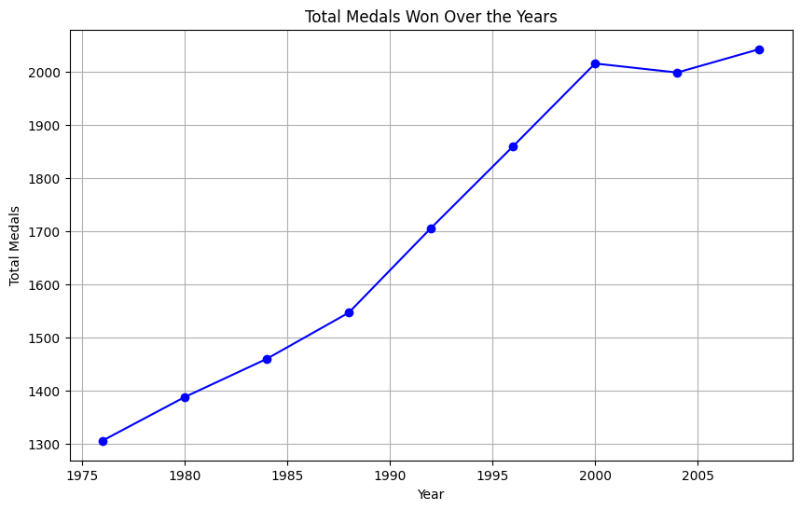
Medals Won Over the Years
Key Insights : A spike in medals in some years due to increased participation. Some countries saw a decline post-1990 due to political factors.
Notes:
6

Slide 8
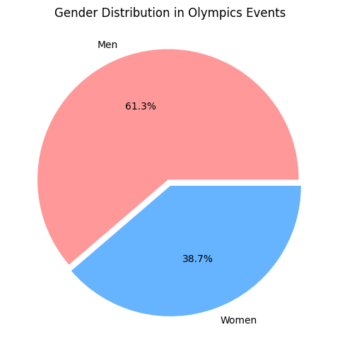
Gender Distribution over Events
Key Insights :
The number of female participants increased significantly after 1980.
Some events are still male-dominated, while others have balanced participation.
Notes:
6

Slide 9
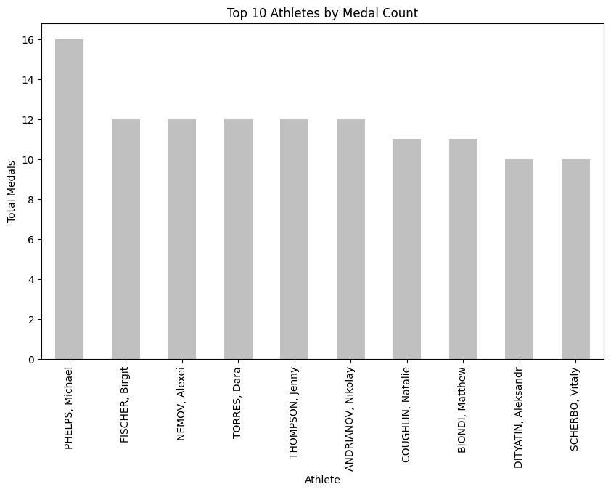
Top Athletes in Olympic History
Key Insights :
Michael Phelps has dominated swimming. Gymnastics and Athletics contribute significantly to medal wins.
Notes:
6

Slide 10
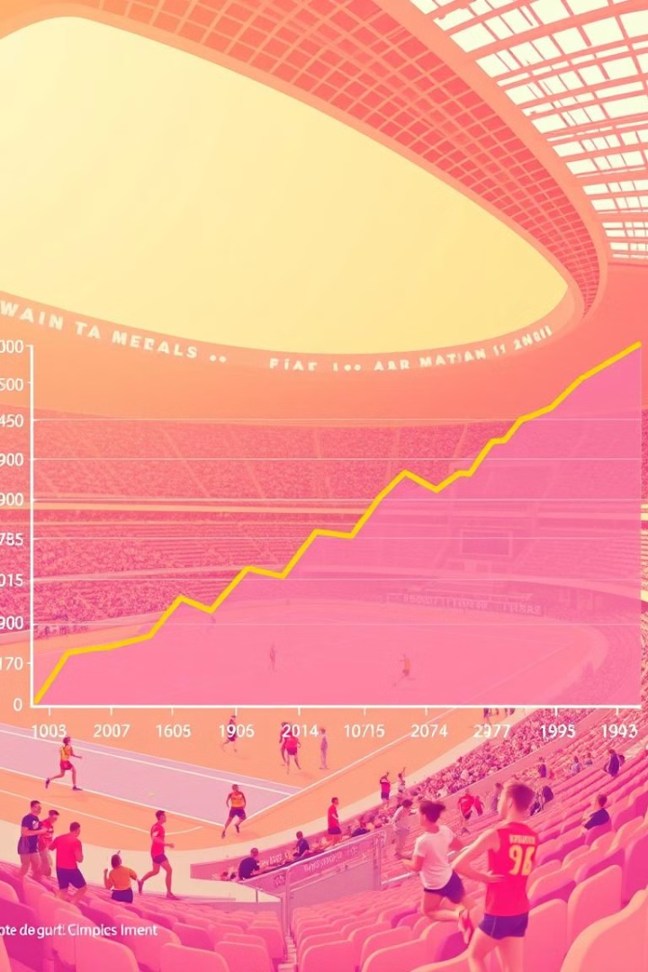
Trends in Medal Wins Over the Years
1
Medal Spike
Increased participation in some years.
2
Post-1990 Decline
Political factors influenced some countries.
Notes:
7

Slide 11
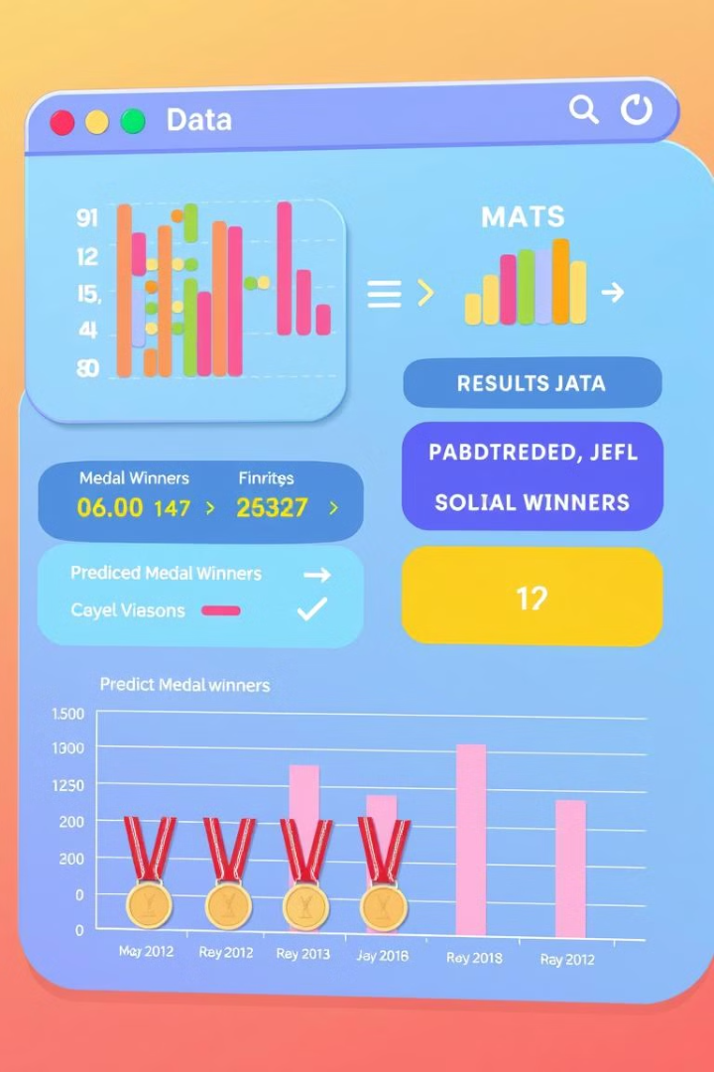




Can We Predict Medal Winners?
Logistic Regression
Features Used
Accuracy
Country, sport, gender, event type.
75% accuracy achieved.
Predict medal wins based on factors.
Key Finding
Country and sport type have the highest impact.
Notes:
8

Slide 12
Summary of Insights
Top Performers
USA, USSR, China.
Popular Sports
Athletics, Swimming, Gymnastics.
Gender Trends
Steady increase in female participation.
Medal Trends
Political and economic changes influenced performance.
Machine Learning
Predicting medal chances with reasonable accuracy.
Notes:
9

Slide 13




Next Steps & Further Analysis
Model Improvement
Add more features, use advanced models.
Dataset Expansion
Include more recent Olympics.
Real-Time Integration
Connect with live Olympic stats.
Notes:
10

Slide 14


Slide 15

Contact Me
Email: ds075156@gmail.com
LinkedIn: https://www.linkedin.com/in/dhruvsingh-data-analyst/
GitHub: http://github.com/dhru07

